Slide 1
Treasurer Seminar for Groups and Zones
By Kathryn Richard, District Financial Secretary
and Relda Galli, District Treasurer
KAOL July 15, 2023

Slide 2
Treasurer vs. Financial Secretary
Treasurer
Writes checks for grant disbursements and expenses
Oversees & provides accounting for the whole of the district’s expenses
Financial Secretary
Receives and provides recordkeeping of Mite offerings & other remittances
Sends out supplies of mite boxes
Relda Galli, Treasurer Kathryn Richard, Financial Secretary
email: treasurer@kansaslwml.org email: financialsecretary@kansaslwml.org
Notes:
Show this slide after questions 1 and 2 as summary of two

Slide 3
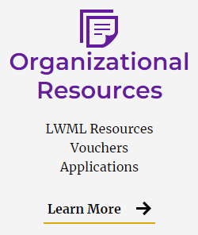
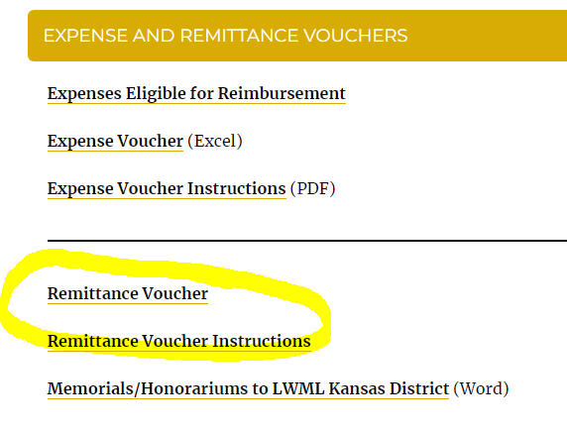
Mite Offerings and Donations
Remittance Voucher forms can be
found at kansaslwml.org under
organizational Resources at the
bottom of the Home Page
Notes:
This slide after Q?

Slide 4
Online Giving click on the Giving Tab at kansaslwml.org
Notes:
For online giving, go to our website at kansaslwml.org. Select Donate Now or Ways to Give from the drop-down menu.

Slide 5
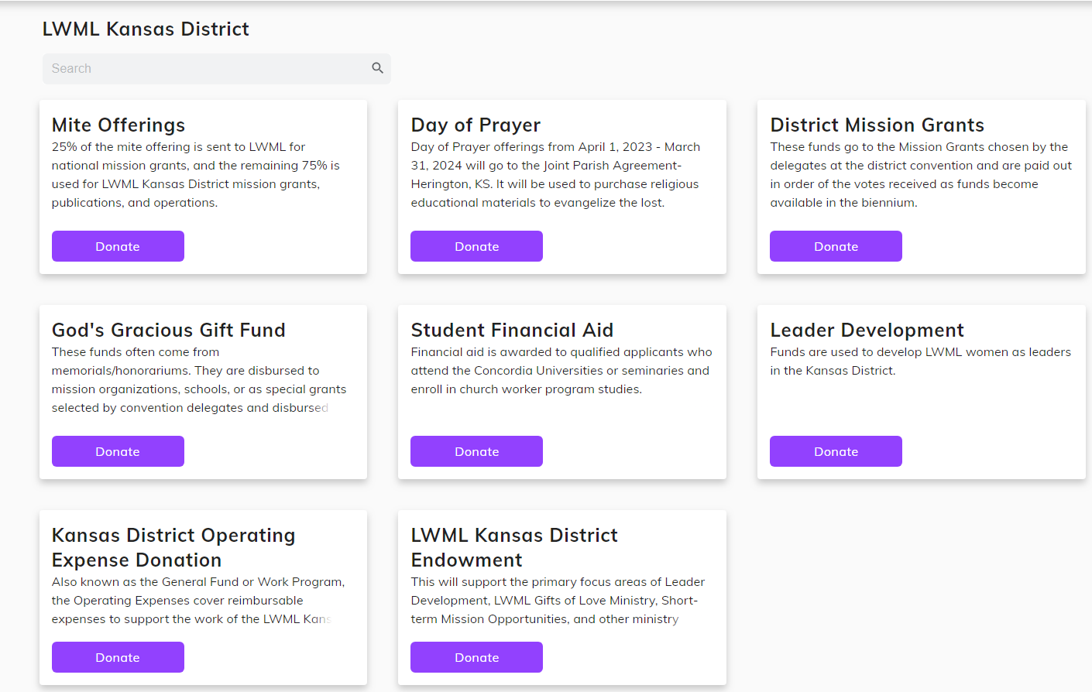
Click the ‘donate’ button to make an offering to any of these funds!
Notes:
This is the Giving page.

Slide 6
Donations can be made from bank accounts (no fees) or credit/debit cards (fees, but there is an option to cover the fees so the total amount goes to mite offerings, missions, GGGF, etc).
Anyone can give a one-time donation as a guest.
Sign up to create an account and log in each time so you can save your payment methods, set up recurring donations, and view your giving history.
NOTE: If you sign up with the mobile app, you are also signed up for online, and vice versa.

Slide 7
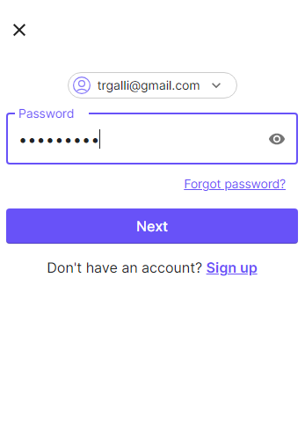
Create an account for your group or personal use from your desktop.
The program walks you through each step and you have the option to save your payment methods (debit or credit card or bank account). You can change your password or email under profile settings and find both scheduled payments or history of payments under the transaction tab
OR Log in to your existing account

Slide 8
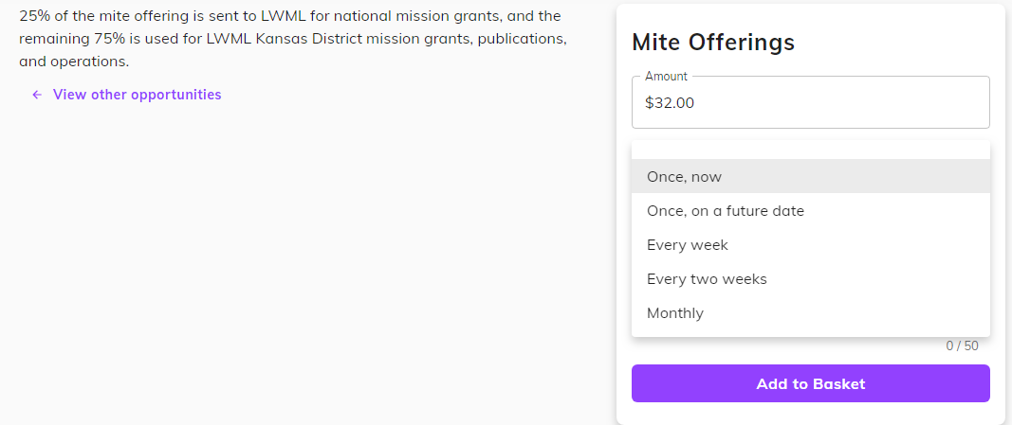
The following screens are snips of making a donation.
You can select the frequency of your payment: A one time for groups when mite offerings are remitted or for a memorial gift or you can set up a monthly offering for your personal giving. Lots of options!

Slide 9
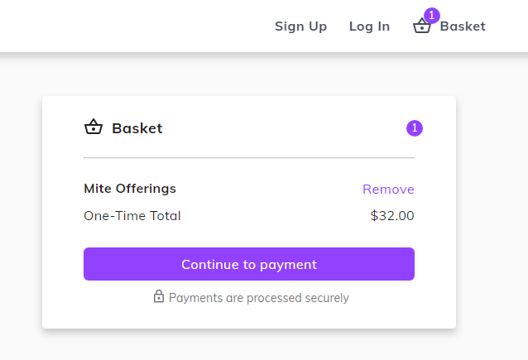
Notes:
Continue scrolling down the Giving page.

Slide 10
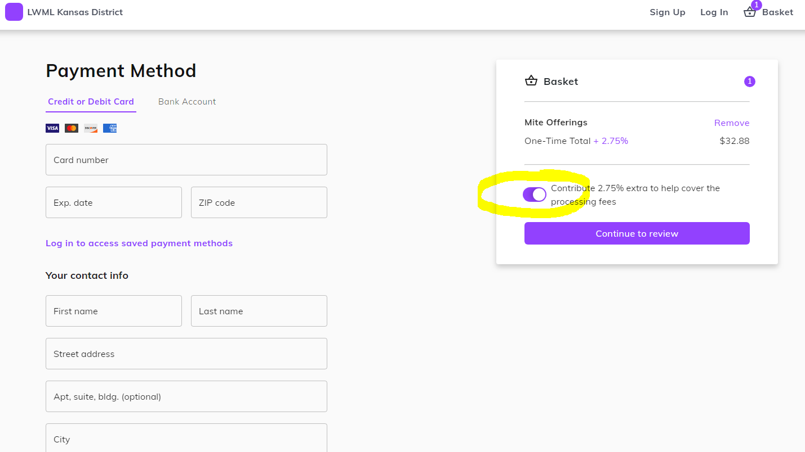

Slide 11
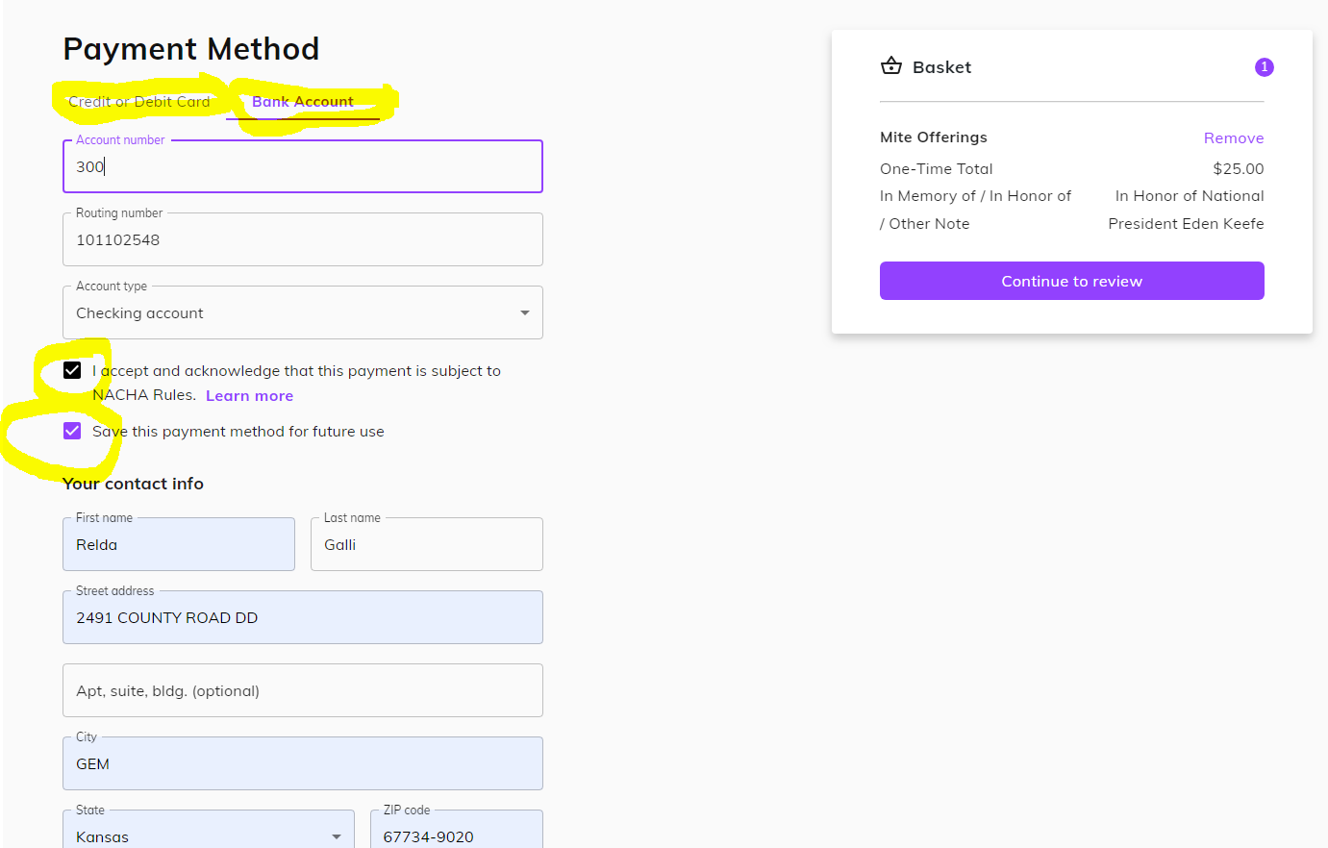

Slide 12
The program walks you through each step and you have the option to save your payment methods (debit or credit card or bank account). You can change your password or email under profile settings and find both scheduled payments or history of payments under the transactions tab

Slide 13
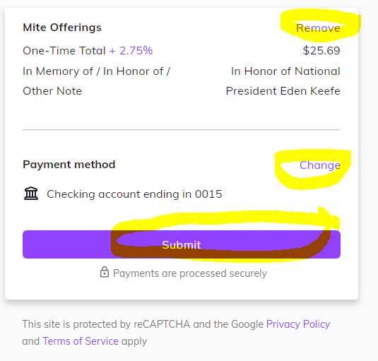
You still have options to make
changes until you click the
Submit button

Slide 14
You will receive an email receipt each time you submit an offering

Slide 15
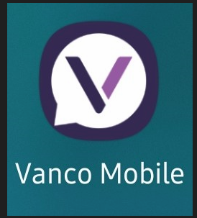
Mobile App Set-Up: Vanco Mobile Faith Engagement App
App icon looks like this in Google Play
Notes:
The Giving page also has information on downloading and using the Vanco Mobile app to give using your smartphone.

Slide 16
