Slide 1
Treasure Hunt for Resources
Christian Life Department

Slide 2
Prayer Walk

Slide 3
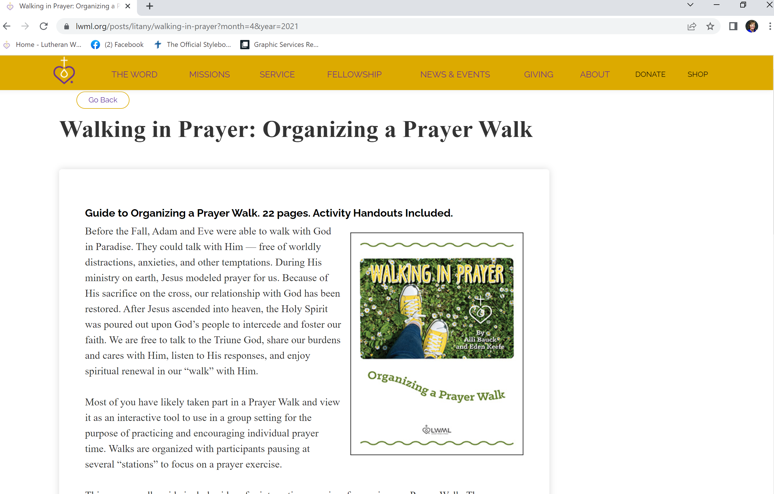

Slide 4
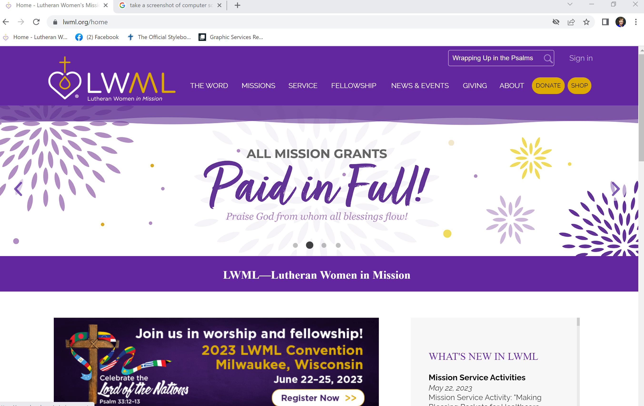
Wrapping Up in the Psalms: God’s Quilt of Comfort

Slide 5
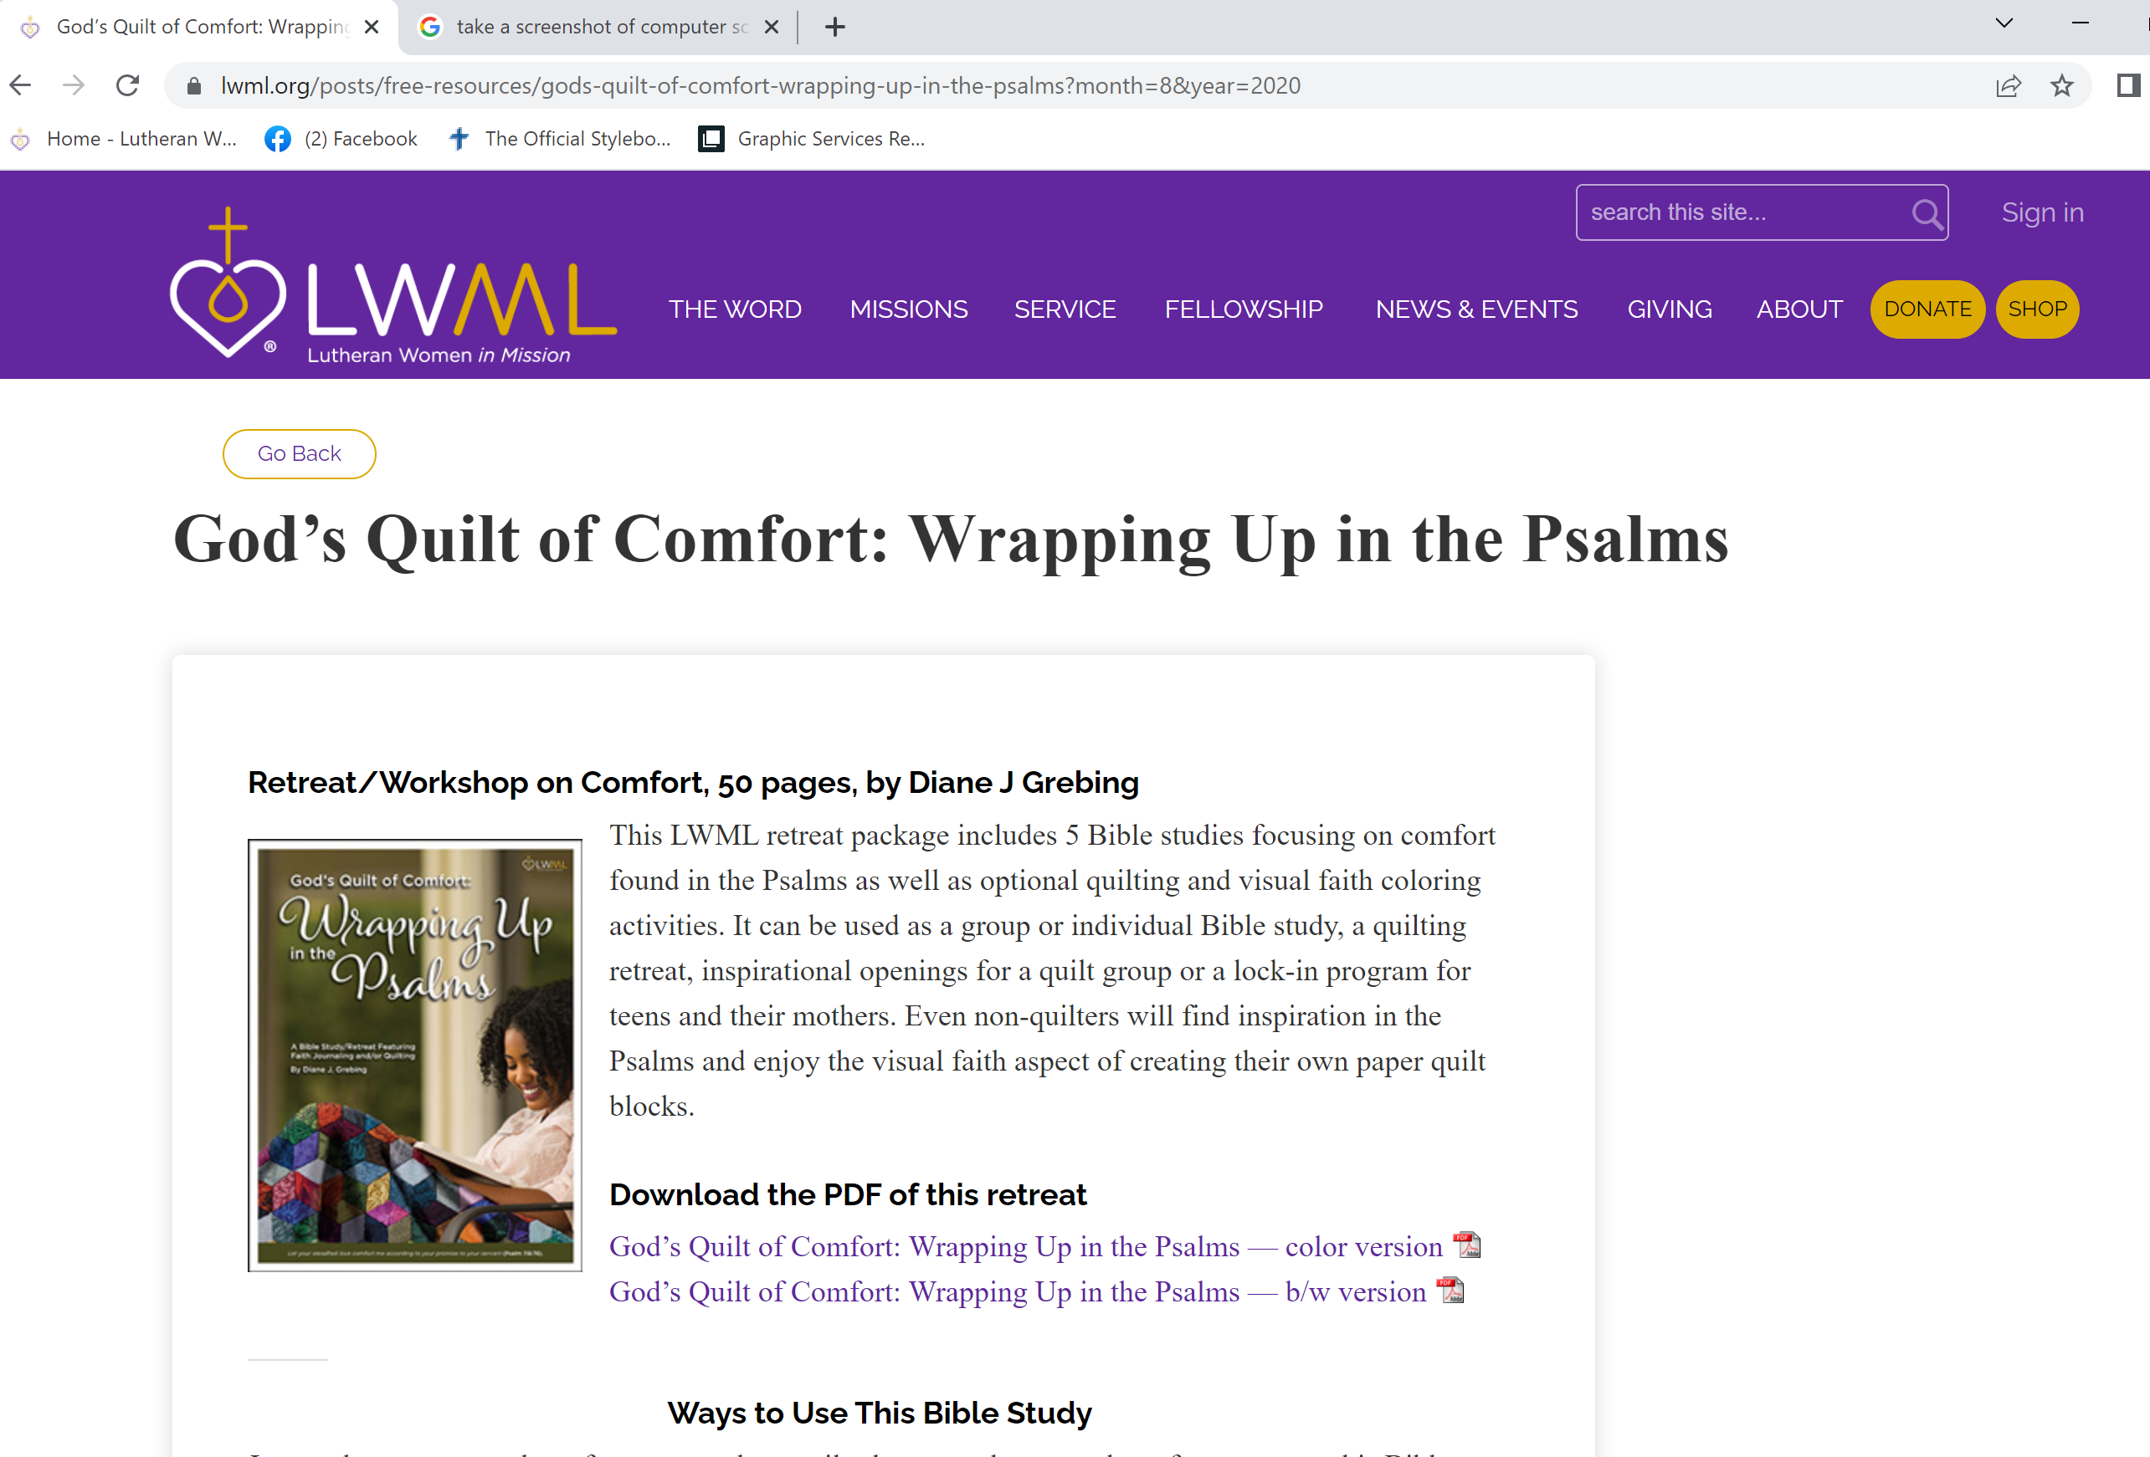

Slide 6
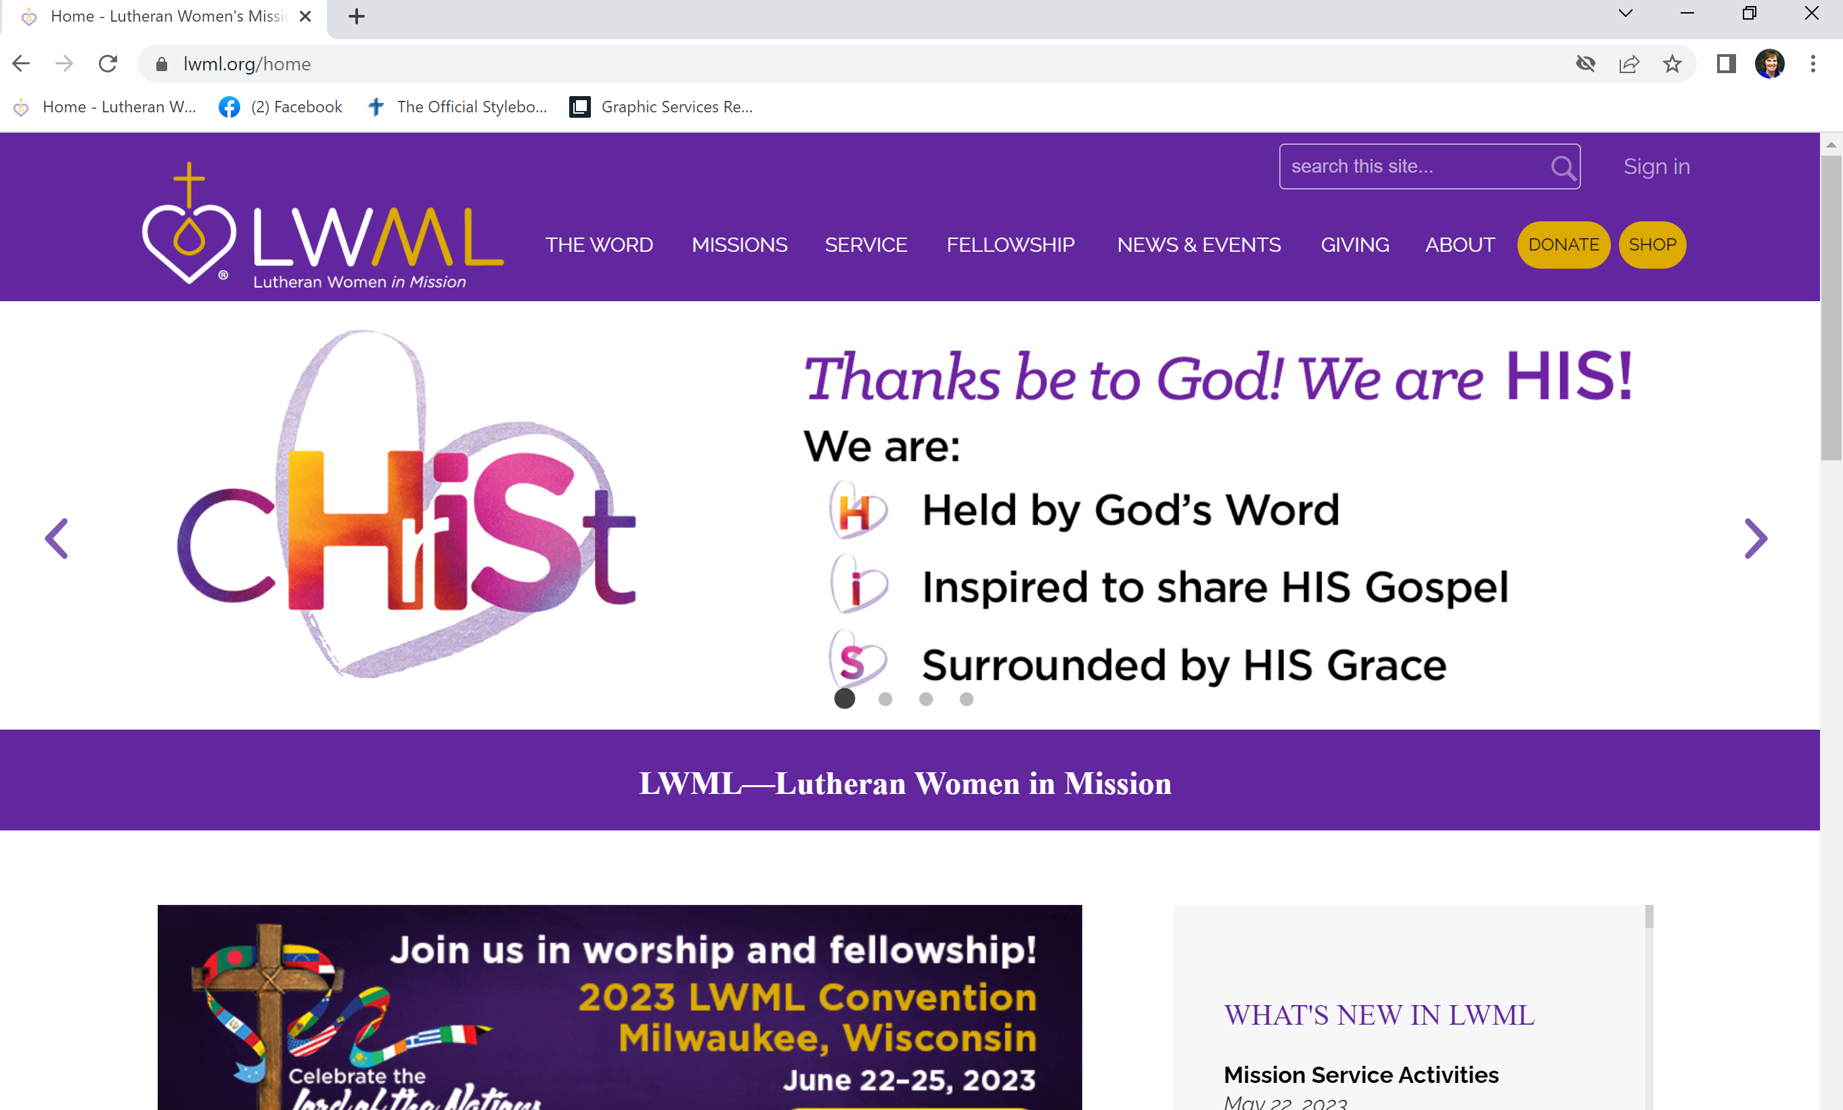
Life After … Devotions for Widows

Slide 7
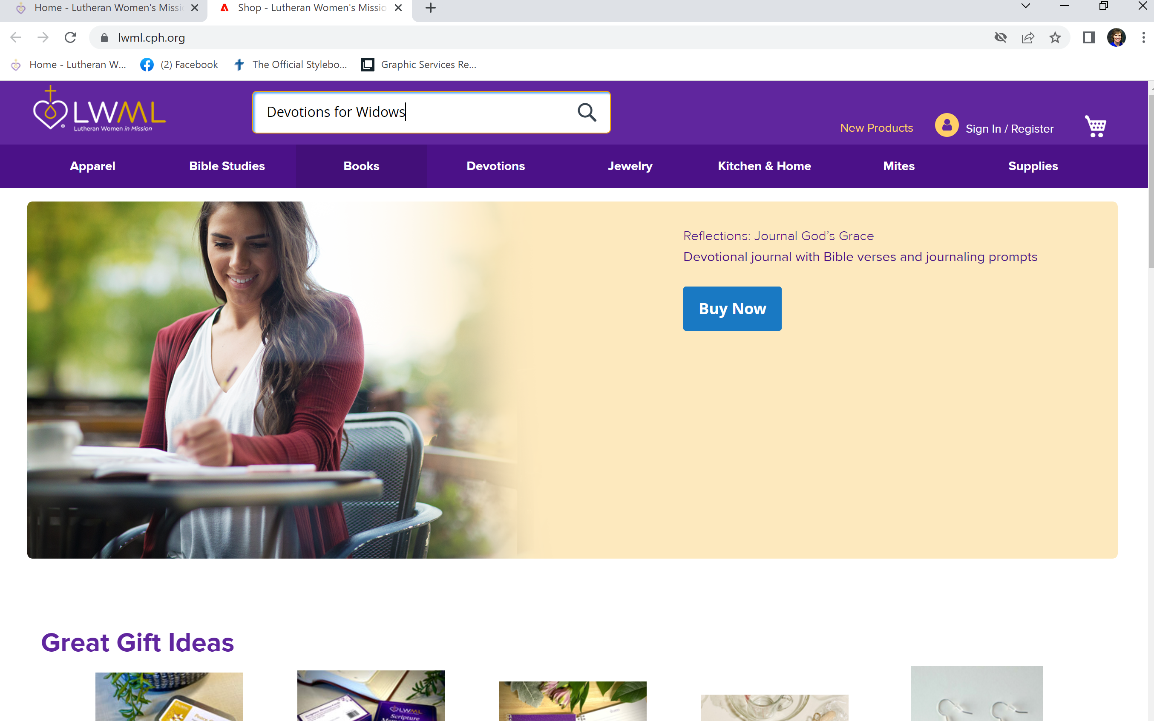

Slide 8
A Missionary ? Me?

Slide 10
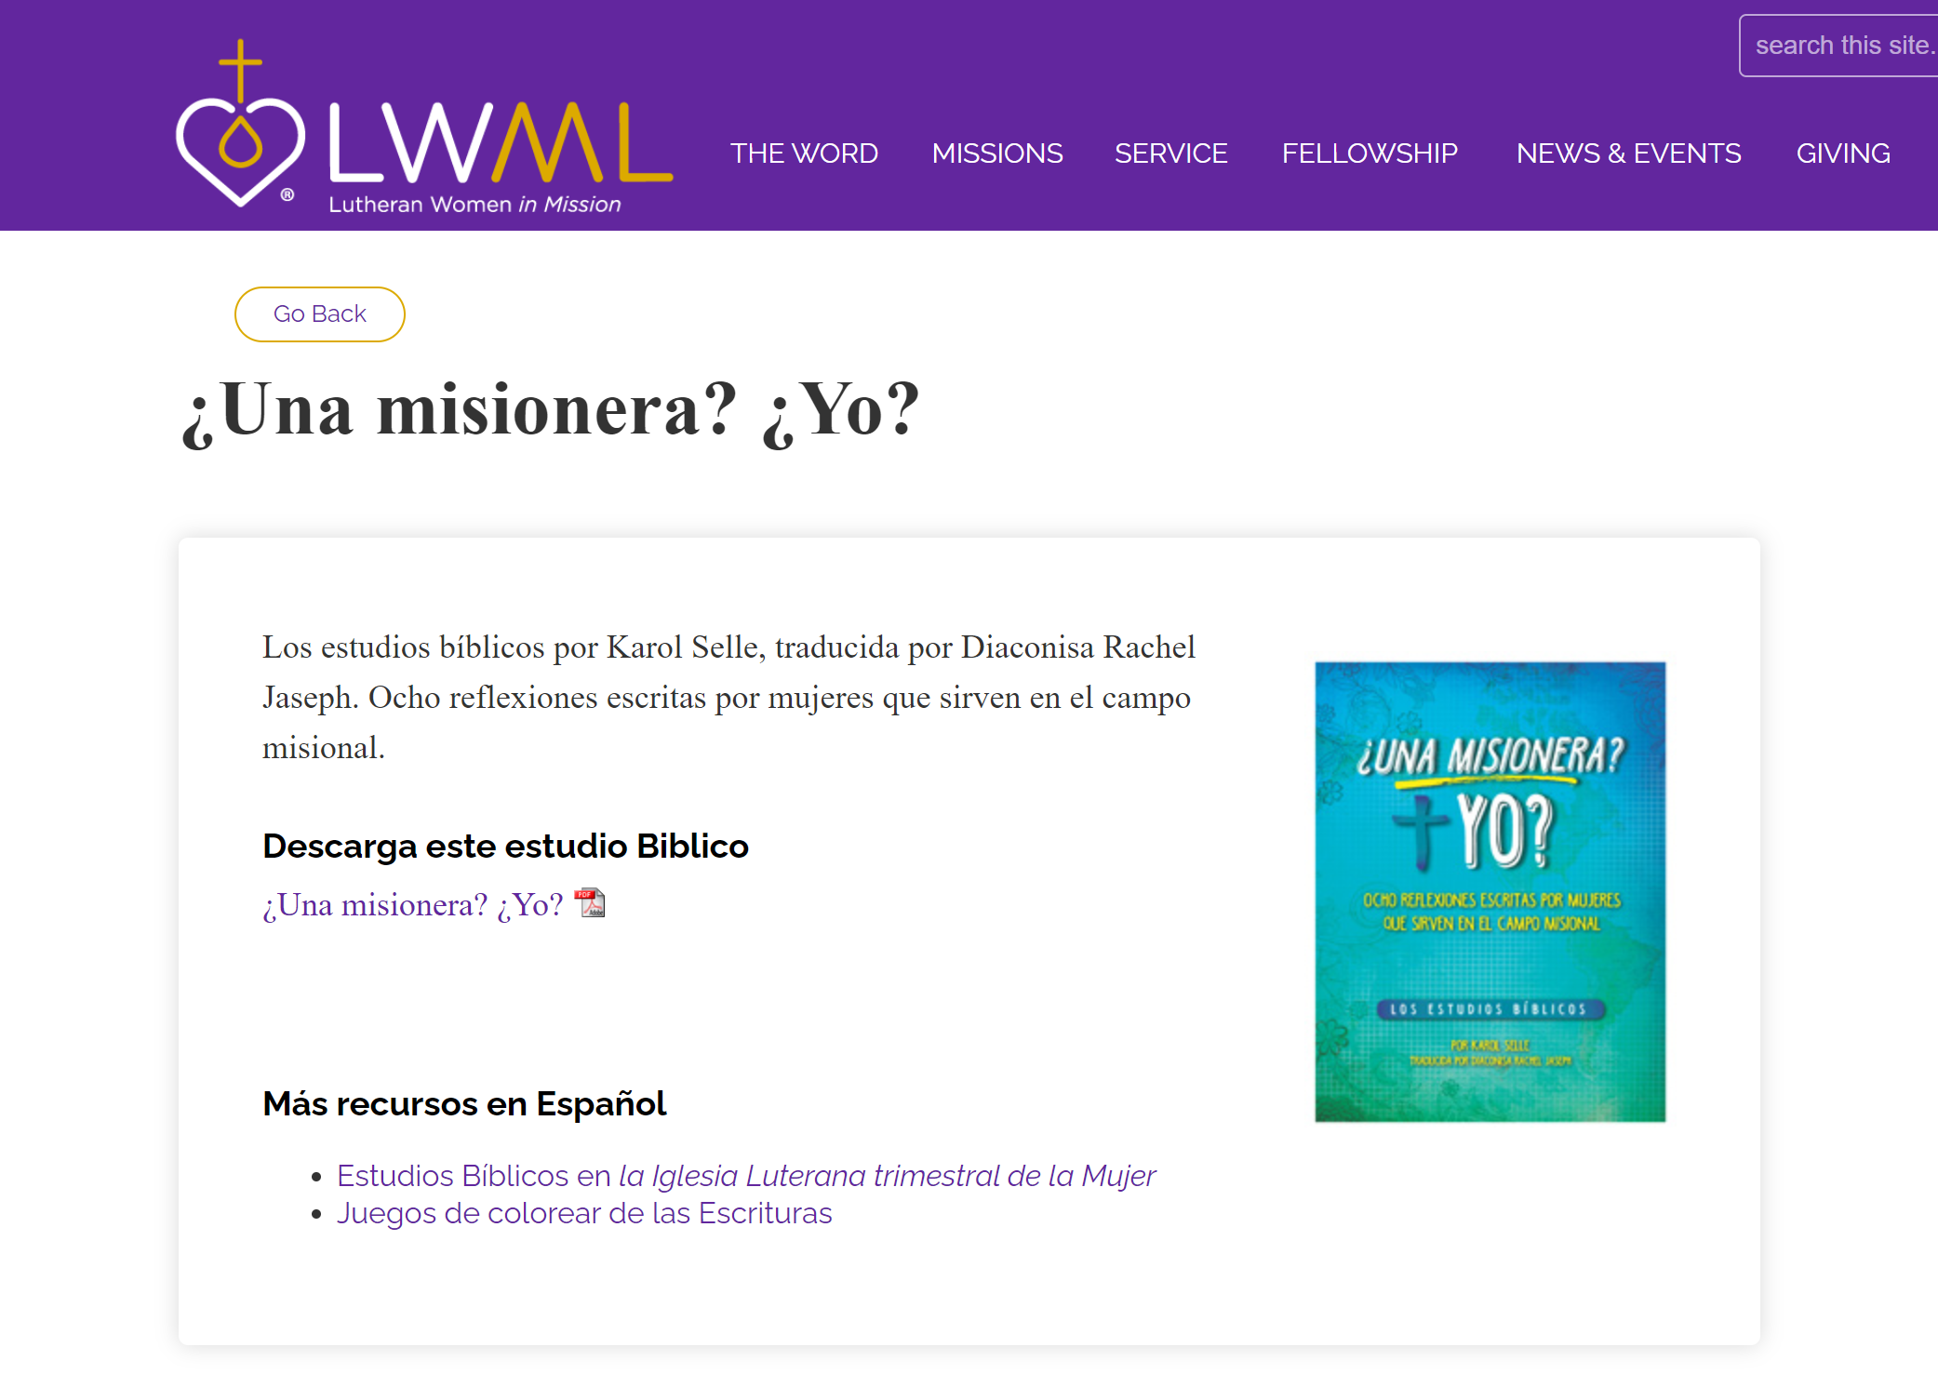

Slide 11
Crafts

Slide 12
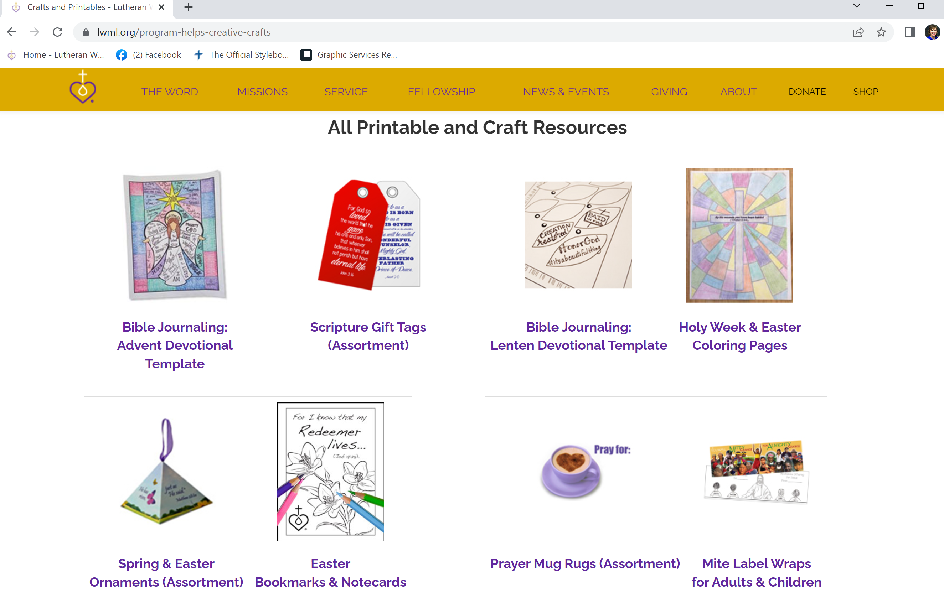

Slide 13
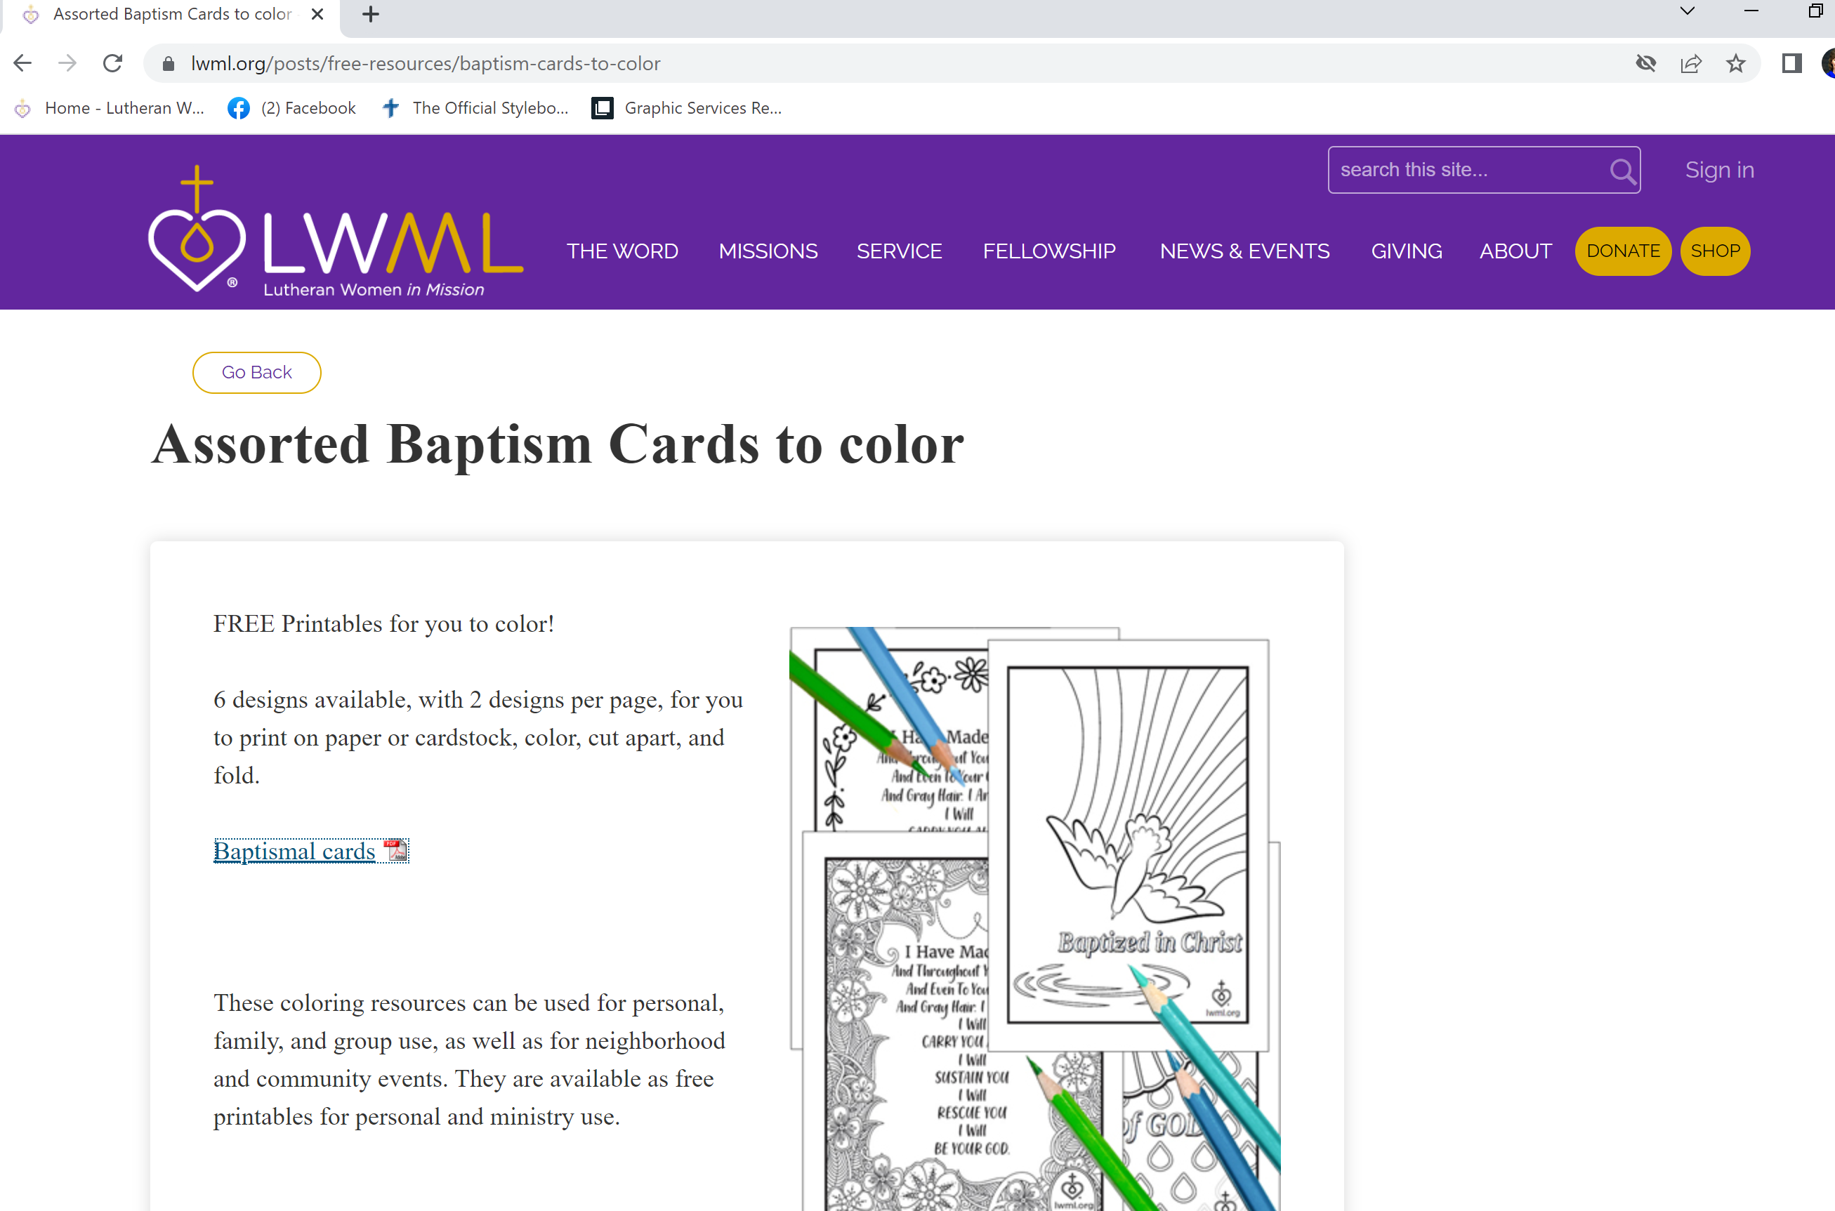

Slide 14
Sharing Caring/Peace/Memory Verse Cards

Slide 15
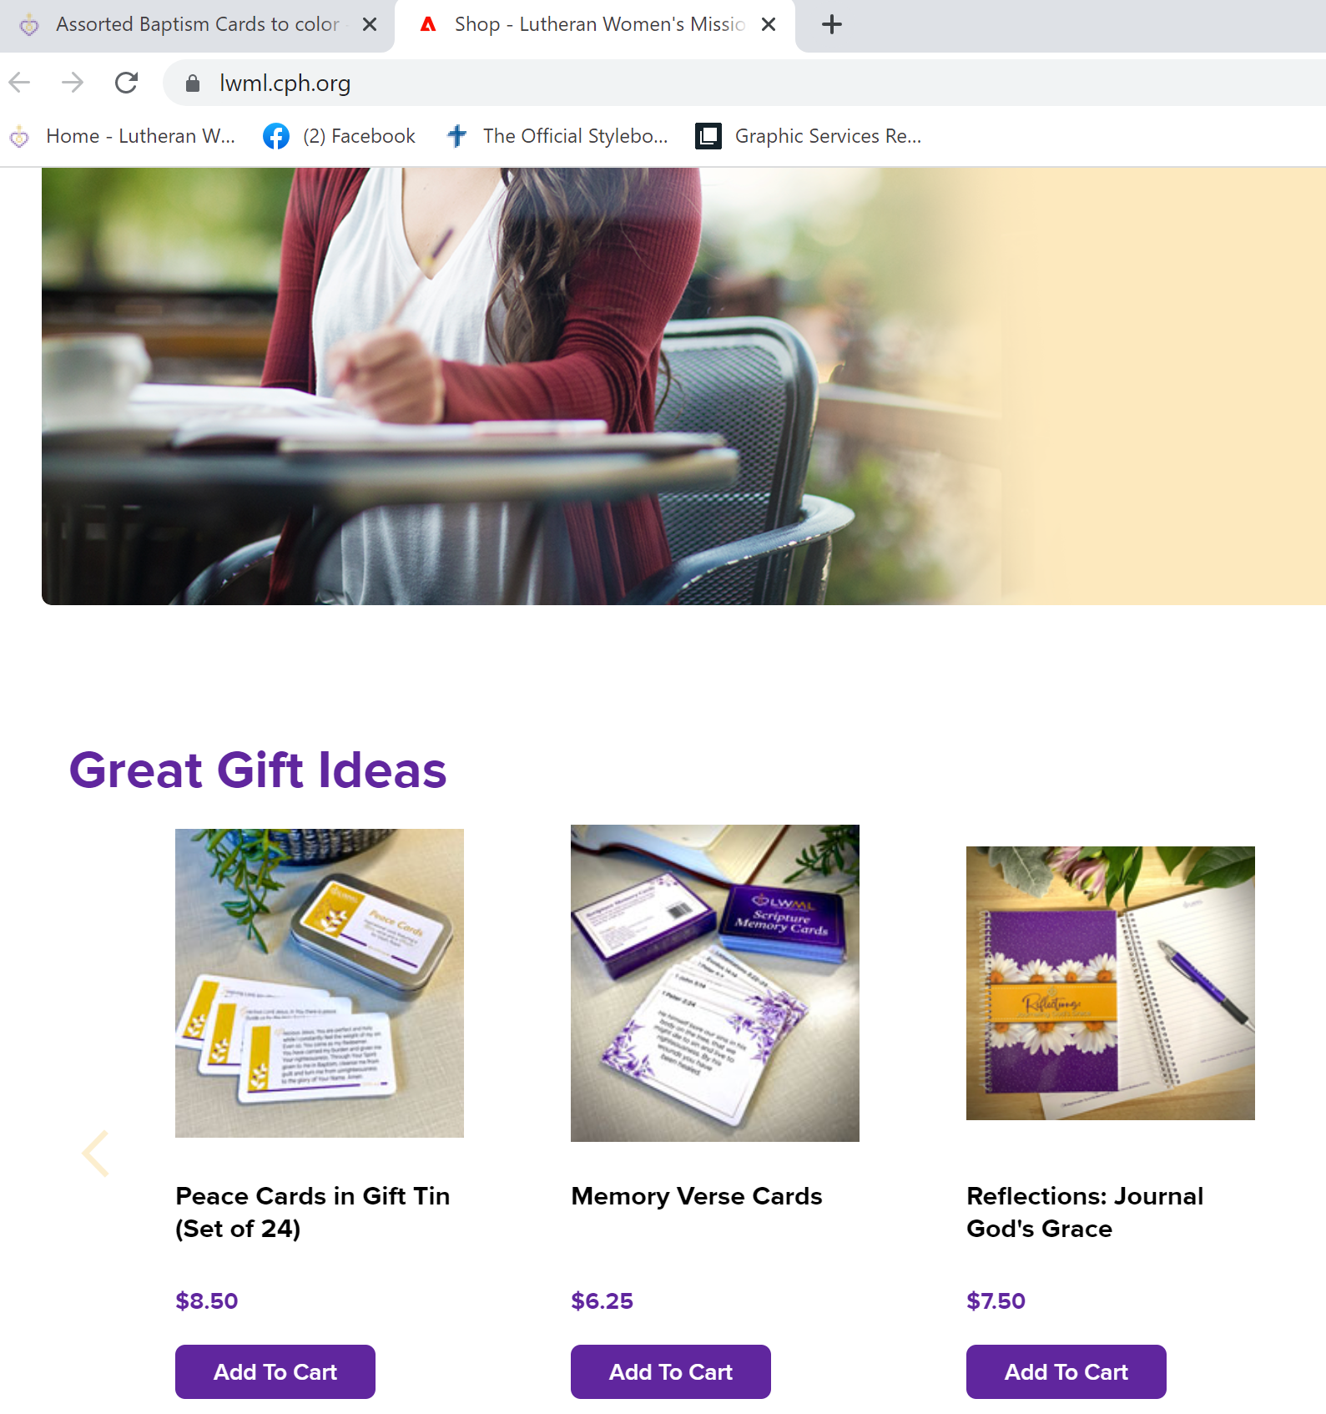

Slide 16
Unshakable

Slide 17
Prayer Service

Slide 18
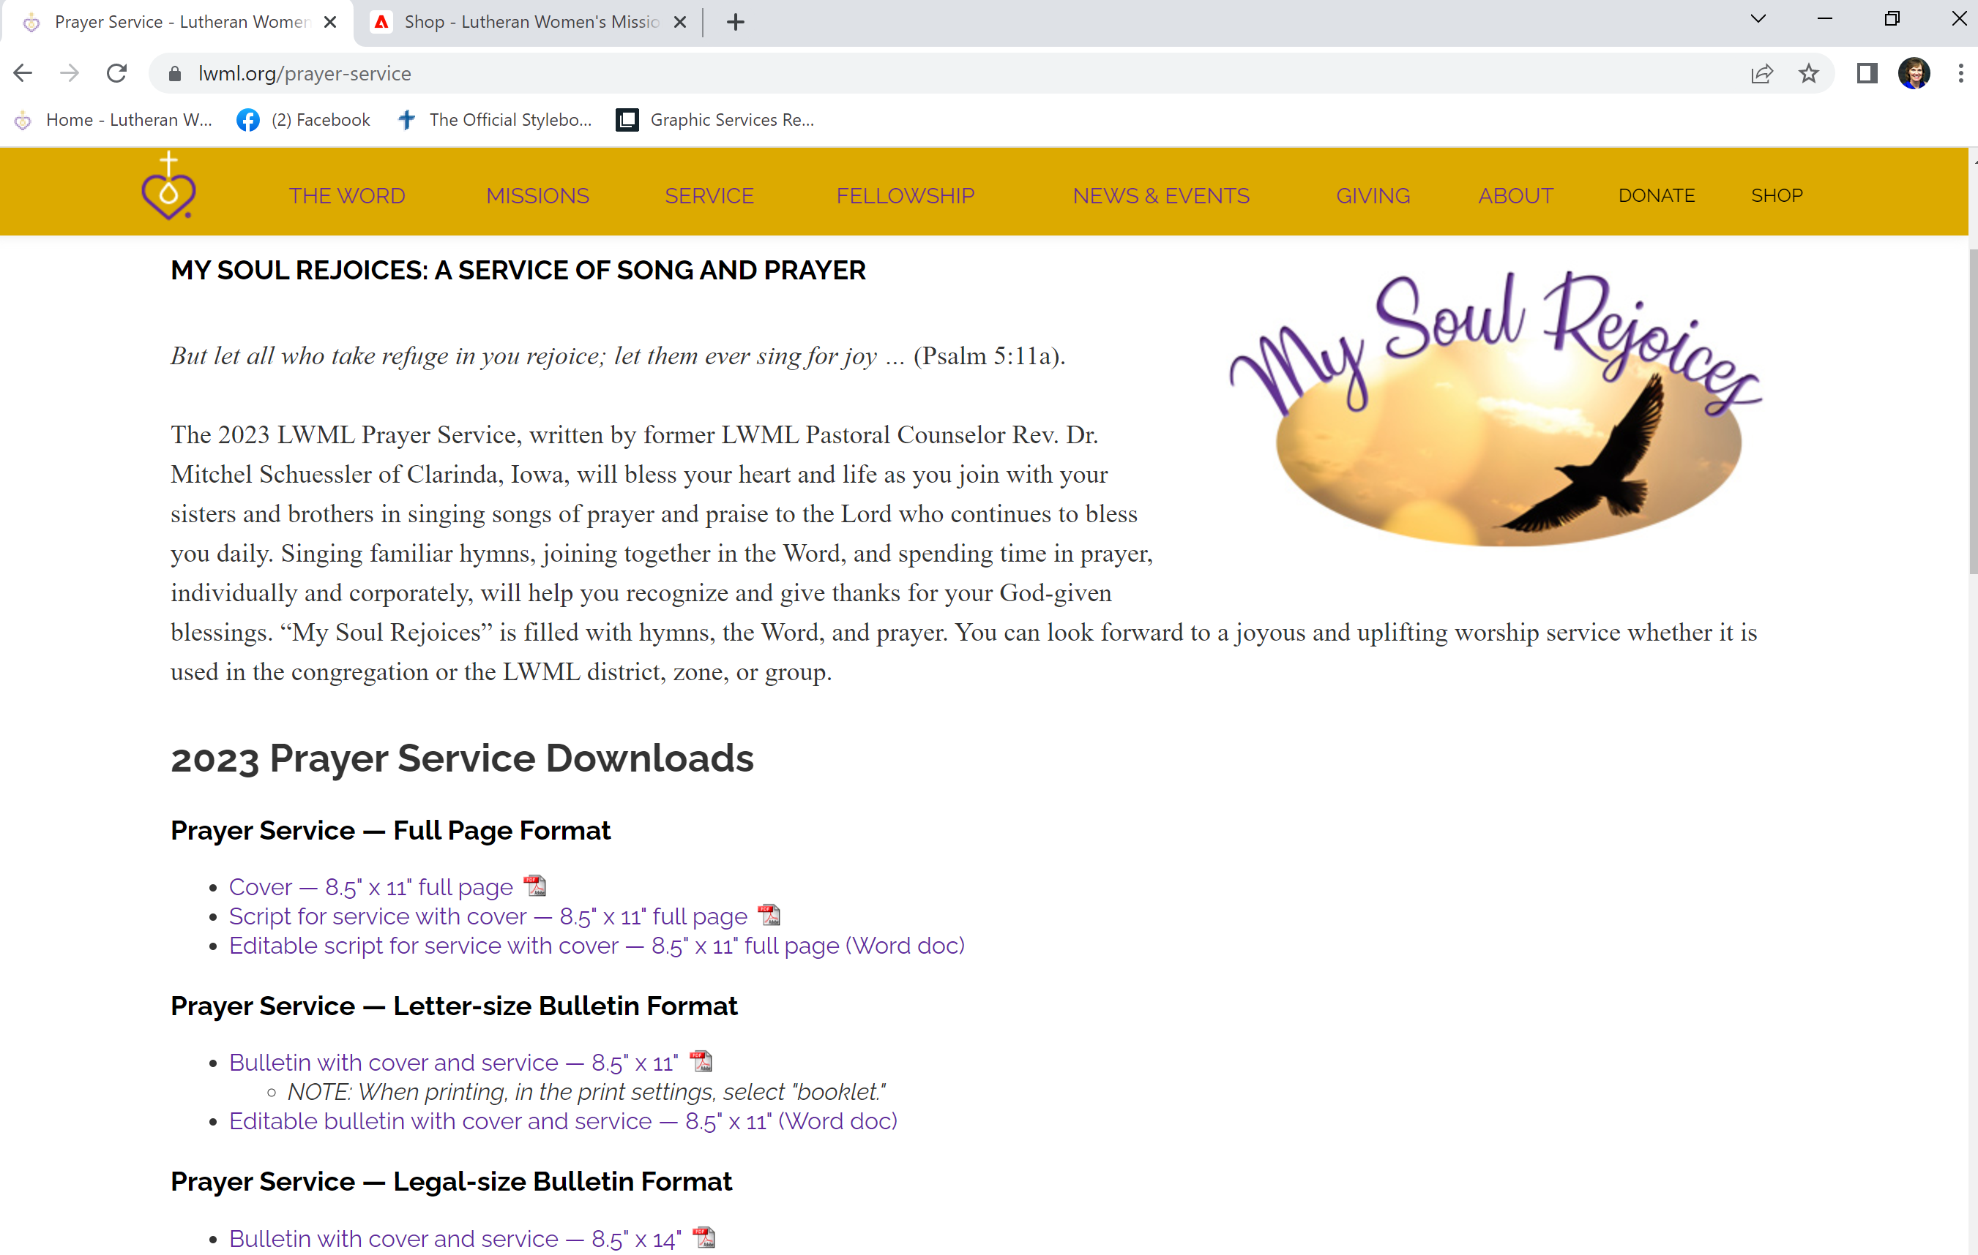

Slide 19
Mission Grant Resources

Slide 22
Mite Box Resources

Slide 24
Equipping Saints to Serve Planner

