Slide 1
Bylaws
Adventures in

Slide 2
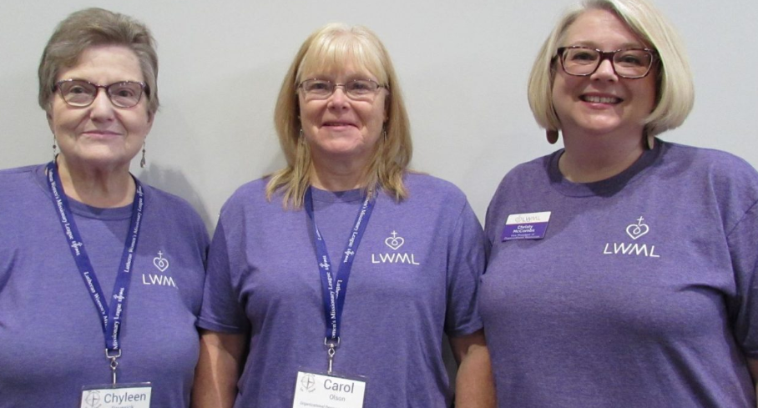
Slide title 3
Organizational Resources Committee Carol Olson – Chair
Gloria Peterson Pastor John Werner Christy McCombs
Chyleen Pauesick – on leave

Slide 3
Slide Title 1
Zone bylaw reviews are cruising in the right direction!

Slide 4
Slide title 4
All the Zones of the Kansas District have made reviewing bylaws a snap!
Lincoln Zone & Topeka Zone have reviewed and ratified their bylaws.
Kansas City CrossRoads Zone & Herington Zone have begun the bylaw review process.

Slide 5
Slide title 8
Where are we off to on our next bylaw adventure?
Linn Zone (July/Aug 2023)
Northwest Zone
(Sept/Oct 2023)

